Slide 1
Observation vs Inference
Scientific Method Unit
8th Grade Science

Slide 2
Observations
Using one or more of your five senses to gather information.
Noting and recording facts about the experience.

Slide 3
Types of Observations
Qualitative Observation: a quality or property of an experience or object being observed that does not get measured (color, taste, sound)
Quantitative observation: a quality of property of an experience or object that can be measured or counted (number, temperature, mass, length)

Slide 4
Examples
Examples | Qualitative or Quanitative?
The insect has many bristles on its legs.
The average length of the insects is 15 cm.
The insect is known to have lived through temperatures as low as 7 degrees below 0.
The insect has circular wings and an equal number of legs on each side.

Slide 5
Inferences
Conclusions based on observations.
Inferences are used to explain your observations.
Inferences are often changed when new observations are made.

Slide 6
Examples
Observation: The rose bush grew 17 cm in one year.
What are some possible inferences?

Slide 7
Examples
Observation: A gardener put a white power around the rose bush in the last example.
What are some possible inferences?

Slide 8
Hypothesis
A hypothesis is an explanation for an event which can be tested.
A hypothesis can be disproven.
This is not just a random guess, it is based on your observations and what you already know.
Put in the form of an "If...then..." statement.
Example: If I water my plants, then they will grow taller.

Slide 9
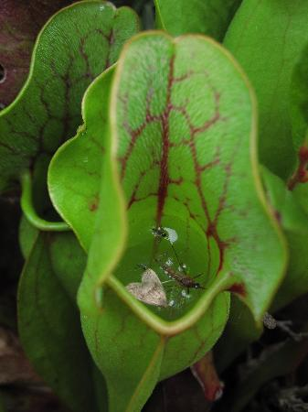
Make observations, an inference, and a hypothesis
Observations: There is a plant in the photo. There are bugs inside the plant.
Inference: This is a carnivorous plant.
Hypothesis: If this is a carnivorous plant, then the bugs will be digested.

Slide 10
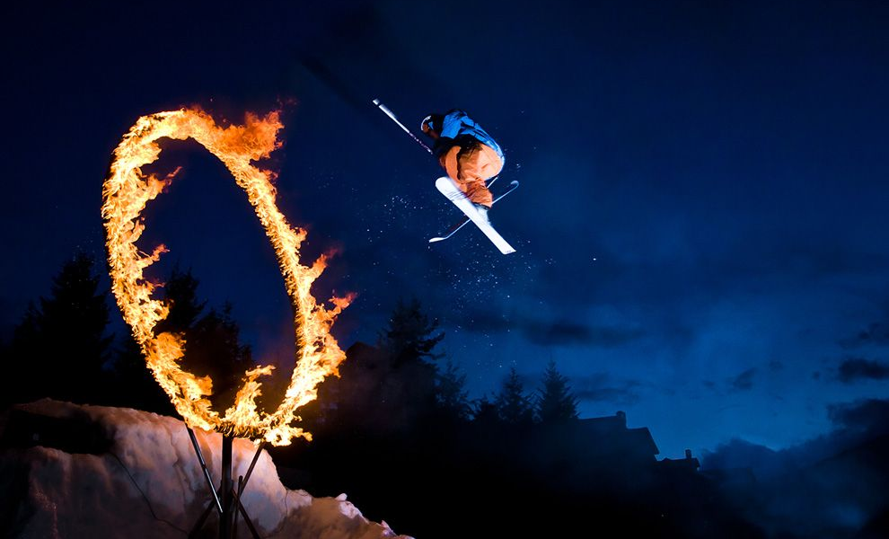
3 observation, 3 inferences
Compare answers with your partner.

Slide 11
3 observation, 3 inferences
Compare answers with your partner.

Slide 12
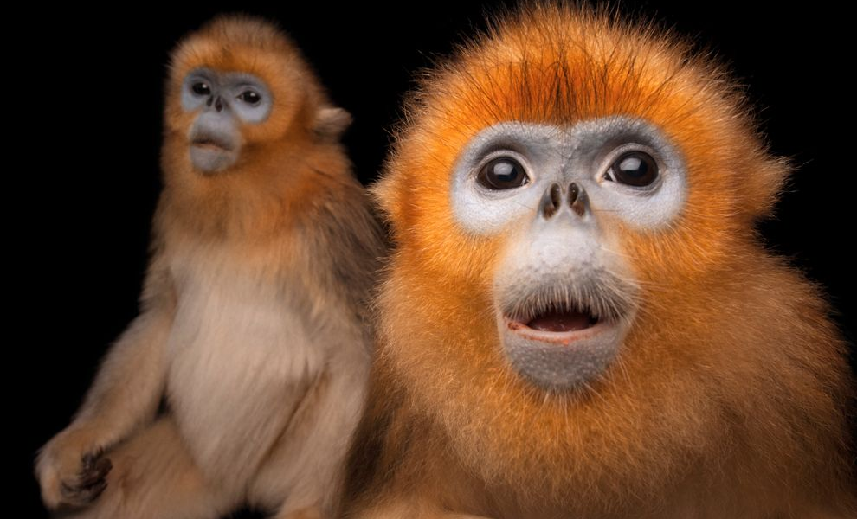
3 observation, 3 inferences
Compare answers with your partner.

Slide 13
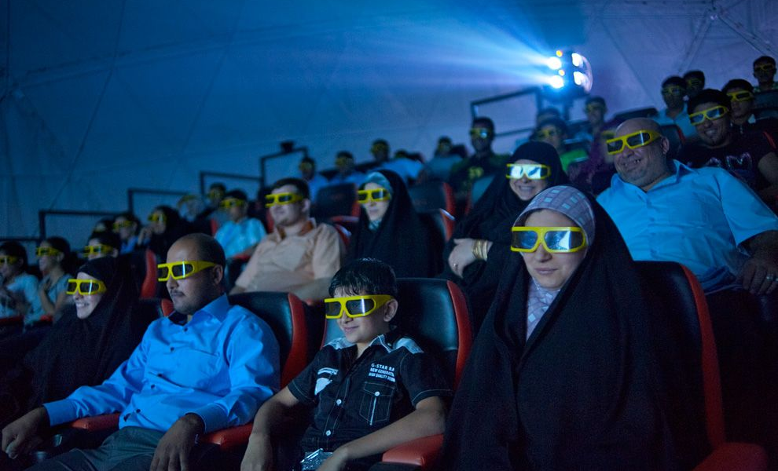
3 observation, 3 inferences, 1 hypothesis
Compare answers with your partner.

Slide 14
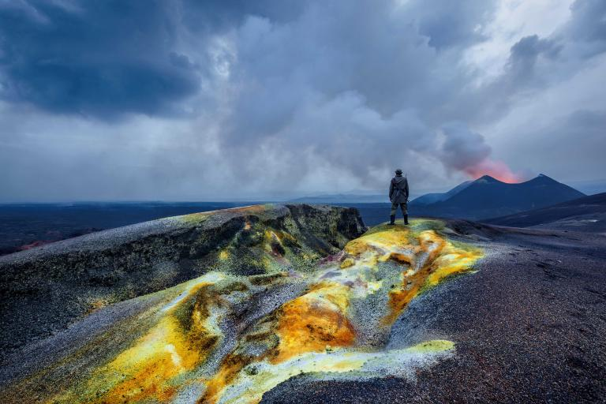
3 observation, 3 inferences, 1 hypothesis
Compare answers with your partner.

